Slide 1

KPI Analysis- Fortis General Hospital
By - Timsy Singh

Slide 2



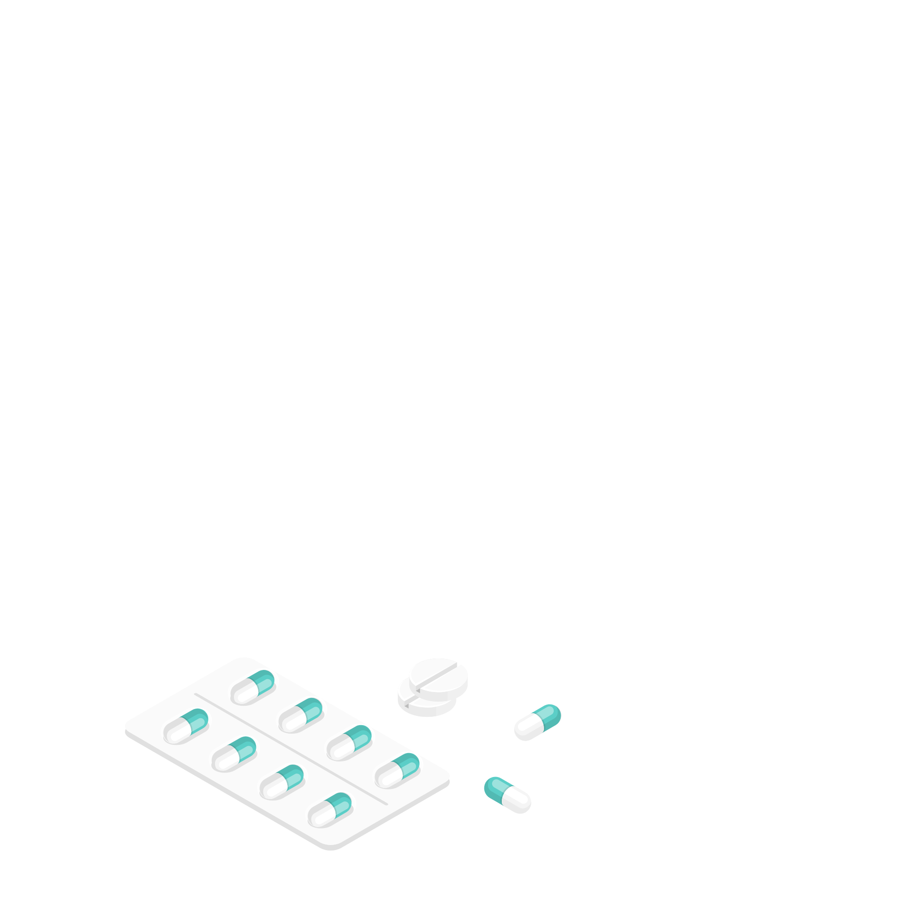
Problem Statement
Fortis General Hospital, long recognized for its exceptional healthcare and leading medical professionals, is now focused on deepening its competitive edge by analyzing key operational and safety metrics that directly impact patient satisfaction and overall service excellence

Slide 3
KPIs Used for Assessment
Average Licensed Bed Occupancy Rate
This metric is internally measured and calculated as the average percentage of licensed beds that are occupied by patients. Average bed occupancy rate= (Number of patients in Licensed bed per day/Number of Licensed bed)*100
Unassisted Fall Rate Per 1,000 Patient Days
This measure is captured by the National Database of Nursing Quality Indicators (NDNQI). A patient fall is defined as an unplanned descent to the floor with or without injury. Unassisted falls are where there is no staff member present to assist the patient. This is measured as: (Number of Patient Falls/Number of Patient Days)*100
Staff Responsiveness Top Box Store
This measure is captured by the Hospital Consumer Assessment of Healthcare Providers and System (HCAHPS) Survey, which is a survey sent out to patients following their discharge from the hospital. It includes two questions in the Staff Responsiveness Domain:
During this hospital stay, after you pressed the call button, how often did you get help as soon as you wanted it?
How often did you get the help in getting to the bathroom or in using a bedpan as soon as you wanted? It is calculated as:
(Number of patients answering “Always” to the two Staff Responsiveness questions/ Number of patients answering the two Staff Responsiveness questions)*100

Slide 4

Data Set Overview
Key Variables
Month
Average Licensed Bed Occupancy Rate
Unassisted Fall Rate per 1,000 Patient Days
Staff Responsiveness Domain Top Box Scores
General Info:
Source: Fortis General Hospital
Size: 60 rows and 4 columns
Timeframe: 5 years

Slide 5

Data Analysis

Slide 6
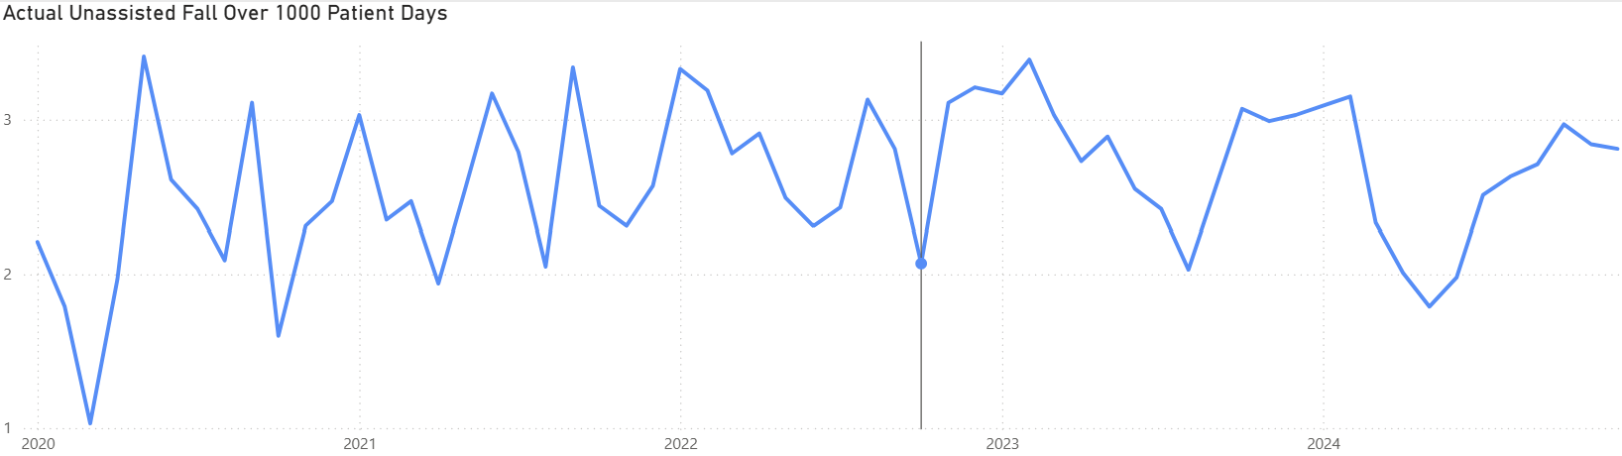
Time Series Decomposition
This is your original time series
Shows significant fluctuations month-to-month, ranging roughly from 1.0 to 3.5 falls per 1000 patient days
There's no obvious sharp spike or crash, but there are periodic peaks and dips suggesting some seasonality

Slide 7
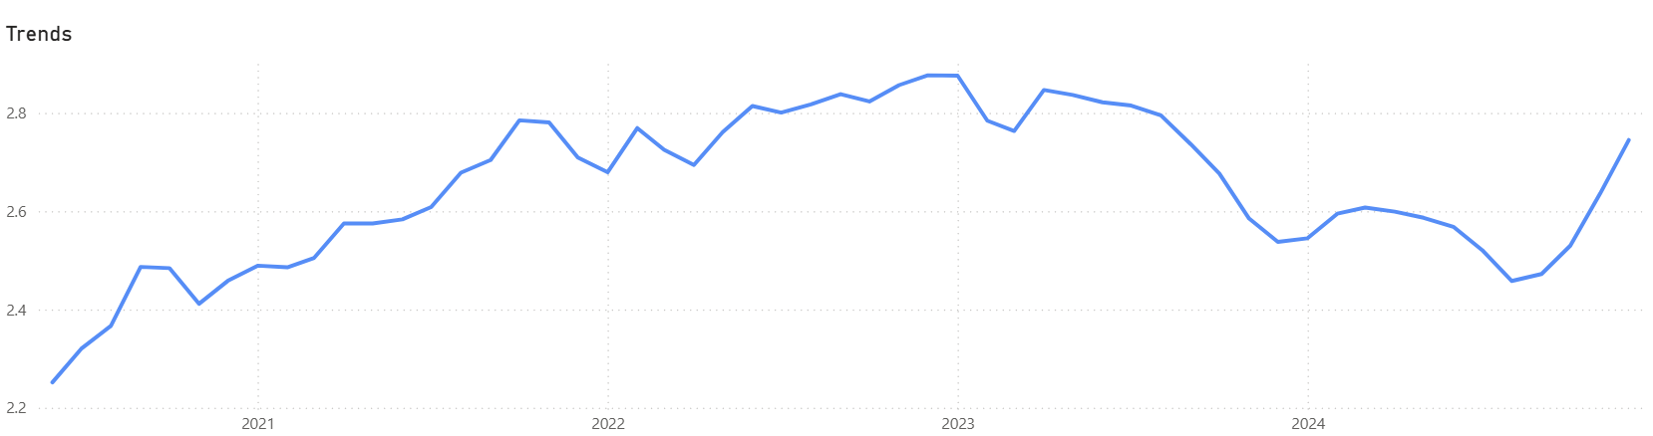
Time Series Decomposition
From early 2020 to around late 2022, there’s a clear upward trend — indicating increasing fall rates
After that, it seems to level off slightly or dip mildly, suggesting some stabilization or decline.

Slide 8
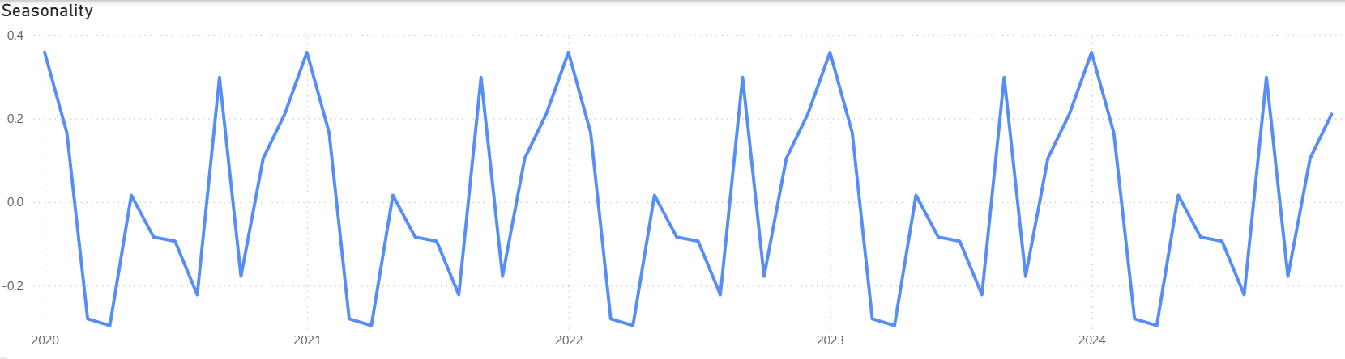
Time Series Decomposition
There’s a regular rise and fall pattern around the same months each year
Higher fall rates in late winter to spring, and lower in summer or early winter are observed clearly

Slide 9
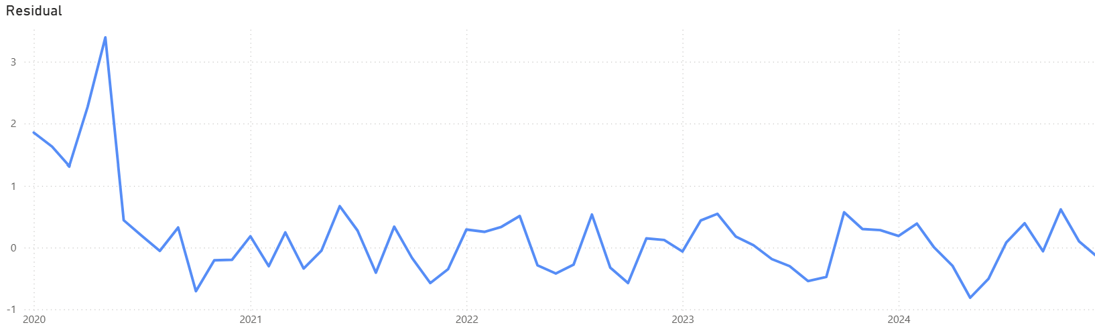

Time Series Decomposition
Can be Outlier
Most values are small, suggesting a good fit by the trend and seasonality models
Occasional spikes or dips indicate unexpected events or outliers

Slide 10

Relationship Between KPIs

Slide 11
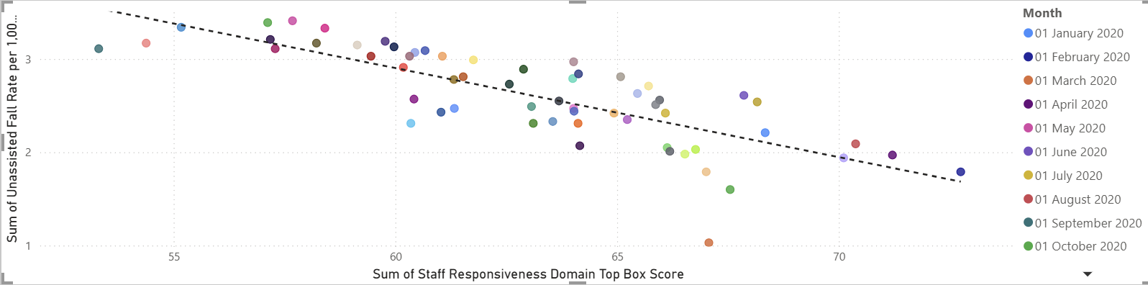
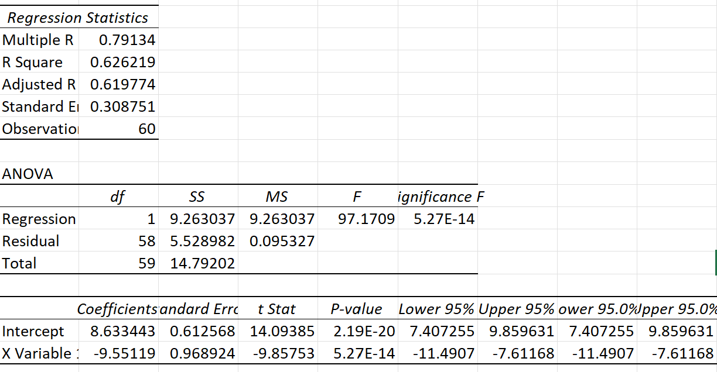
Unassisted Fall Vs Staff Responsiveness
Scatter Graph
Interpretation: The line of best-fit trends downward, indicating a negative correlation. As the Staff Responsiveness increases, Unassisted fall decreases. The data points are fairly close to the trendline, suggesting the relationship is relatively strong. The spread is moderate, which means other variables might also influence fall rate but staff responsiveness is clearly a significant factor
Correlation
Interpretation: The value is negative i.e. -0.79 which shows that they have a strong relationship but negatively.
Regression
Interpretation: The model is statistically significant and explains 62.6% of the variance in the outcome. As x-variable coefficient is -9.55119 therefore for every 1-unit increase in the unassisted fall, the staff responsiveness decreases by 9.55119 units (negative relationship)

Slide 12
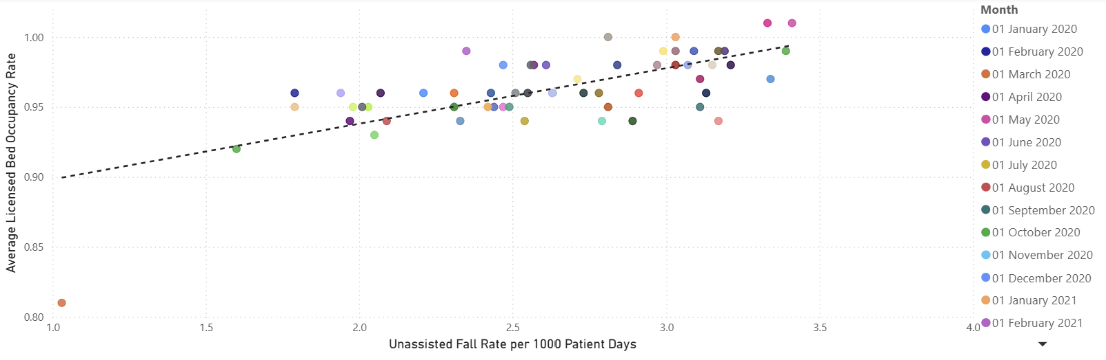
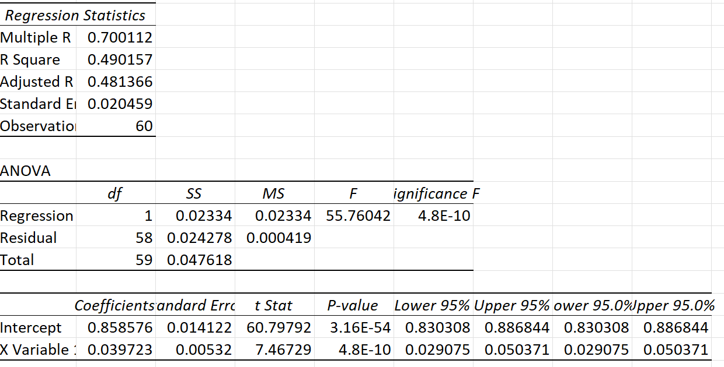
Bed Occupancy Vs Unassisted Fall
Scatter Graph
Interpretation: The line of best-fit trends upward, indicating a positive correlation. As the Unassisted Fall % increases, the bed occupancy % increases and vice-versa is also true. The data points are fairly close to the trendline, suggesting the relationship is relatively strong. The spread is moderate, which means other variables might also influence bed occupancy, but fall rate is clearly a significant factor
Correlation
Interpretation: The value is 0.70 which shows that they have a positive strong relationship.
Regression
Interpretation: The model is statistically significant and explains 49% of the variance in the outcome. As x-variable coefficient is -0.039729 therefore for every 1-unit increase in the unassisted fall, the bed occupancy increases by 0.039729 units

Slide 13
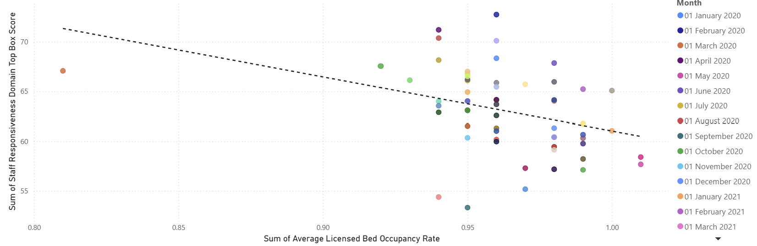
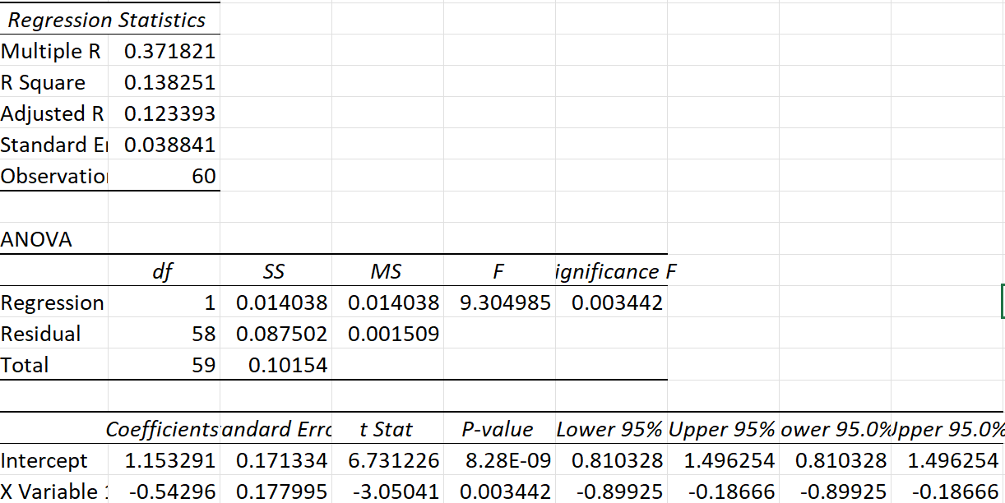
Bed Occupancy Vs Staff Responsiveness
Scatter Graph
Interpretation: The line of best-fit trends upward, indicating a negative correlation. As the Bed occupancy increases, the staff responsiveness decreases. The data points are not close to the trendline, suggesting the relationship is relatively moderate. The spread is weak, which means other variables might also influence staff responsiveness.
Correlation
Interpretation: The value is negative i.e. -0.37 which shows that they have a negative moderate relationship.
Regression
Interpretation: The model is statistically significant and explains 13.8% of the variance in the outcome. As x-variable coefficient is -0.54 therefore for every 1-unit increase in the bed occupancy, the staff responsiveness decreases by 0.54 units

Slide 14

Dashboard
Visual Representation of Findings

Slide 15
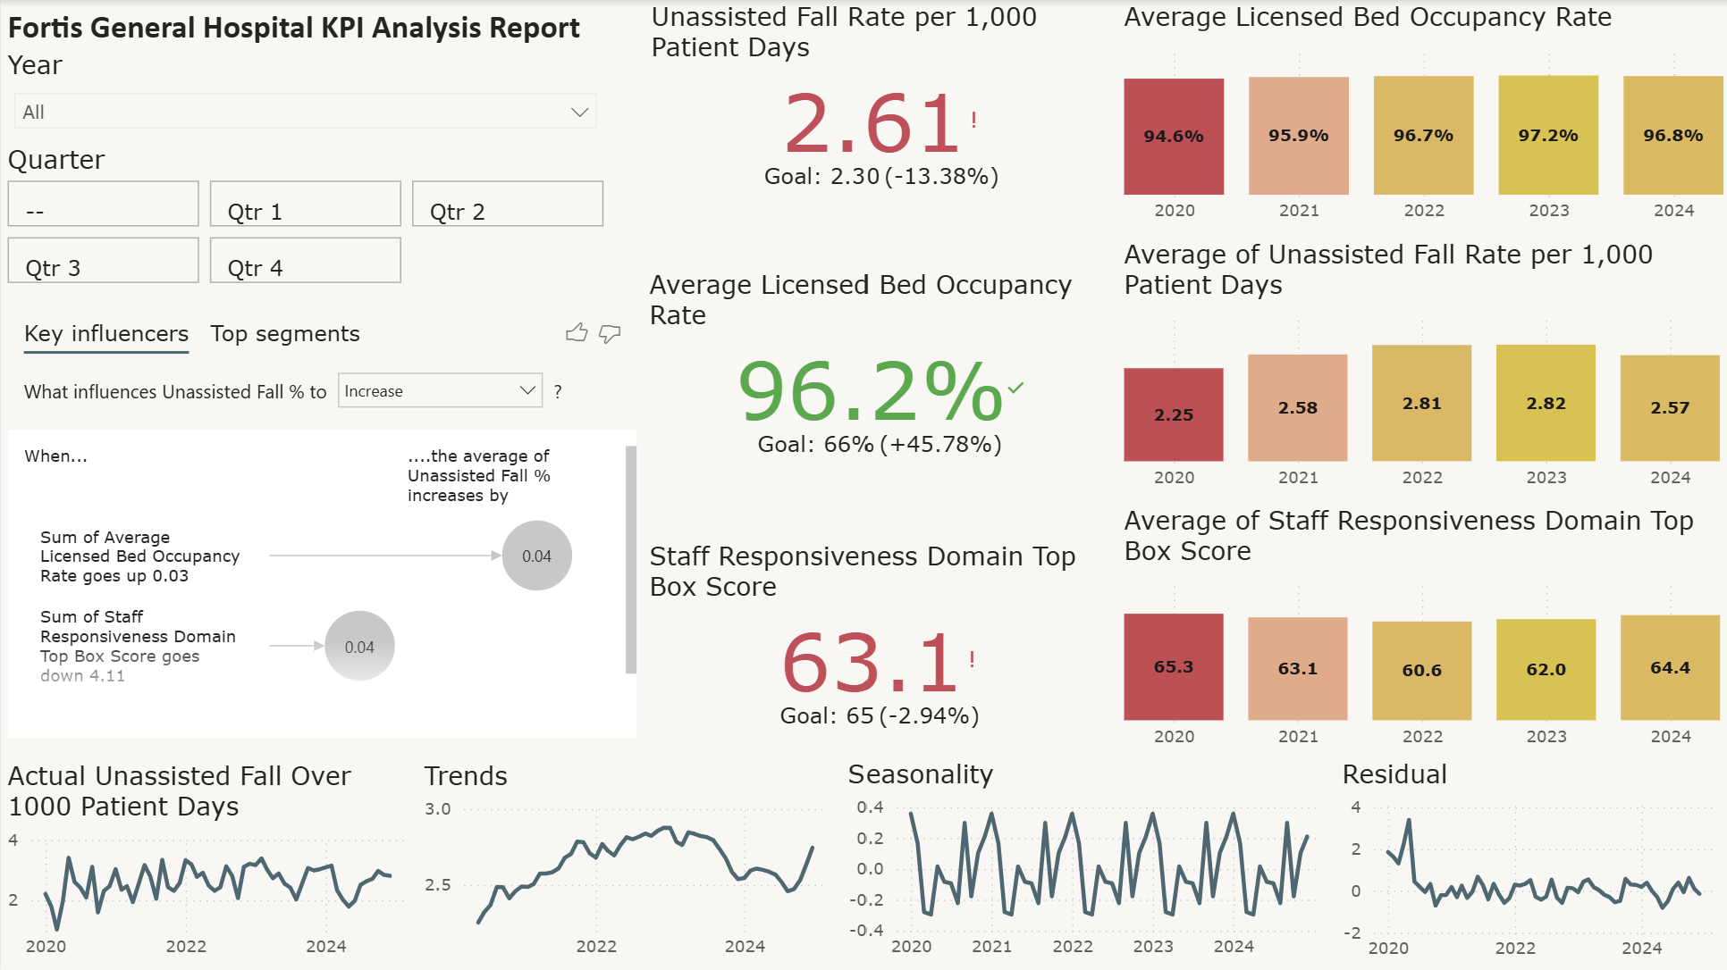


Slide 16
KPIs
Benchmark
Insights
Unassisted Fall Rate per 1,000 Patient Days
2.30
Unassisted fall rates exhibit seasonal patterns, suggesting recurring trends that may be driven by fluctuations in staffing levels or patient volume. Continuous monitoring is essential to prevent increases, especially with high bed occupancy
Average Licensed Bed Occupancy Rate
66%
The Average licensed bed occupancy rate is notably high, indicating strong demand, overcrowding which may also be driven by unassisted falls leading to longer patient stays Higher bed occupancy correlates with reduced staff responsiveness, pointing to staff being overextended during peak occupancy periods, which may compromise patient safety.
65
Increased staff responsiveness is closely linked to a reduction in falls, suggesting that improved staff attention enhances patient safety and lowers the risk of falls, which currently is 2.94% lower than the benchmark.
Staff Responsiveness Top Box Score
Summary - Higher bed occupancy is associated with higher fall rates and slightly lower staff responsiveness.

Slide 17





Action Plan
Better staff and resource allocation is needed
Opting for seasonal hire to cater seasonality and peak time
Increasing the licensed bed number if possible to cater the capacity issue which might be acting as a bottleneck
Providing training to the staff to improve response time

Slide 18


Thank You
Timsy Singh
singhtimsy33@gmail.com

